Slide 1
Julie C. Suarez, Associate Dean for Land Grant Affairs, Director of Translational Research Programs

Slide 2
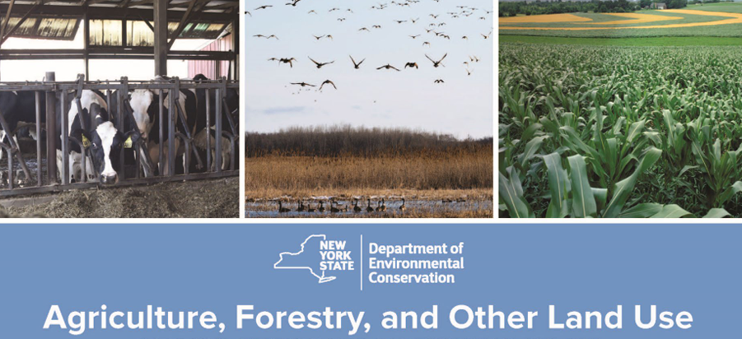
A few framing points on agriculture & forestry
Vision for 2050 is to achieve Net Zero & 85% reduction in 1990 GHG emissions levels.
Some key points:
AEM framework; SWCD
CRF framework
60 MMT CO2e net sequestration is envisioned in ag and forestry
In 2050; will need further reductions to Ag GHG as AG will be projected to be one of largest emitting sectors
Requires further development of research, tech, and market solutions – inc. a bioeconomy.
Notes:
I’m starting with a series of assumptions that I’m going to set forth here. We are all familiar enough with NRCC predictions on what farmers can expect with climate change, and that, yes, climate change is in fact real. If you haven’t read David Wolfe & colleagues updated 2018 projections, I encourage you to do so. Or look at the IPCC NE section of the ag part of the report. Even in some of our more traditional farming communities in NYS, I don’t think there’s much doubt that the climate is changing – the key question is how we as an extension system are going to respond to it. You all know I am not a scientist. I would never pretend to be presumptuous and I’m sure you will find errors in my presentation today. But, what I want to convey to you is how the state’s framework for thinking about climate change is in fact changing in significant and fairly ground breaking ways. Because as an extension system, we need to be thinking about how to help farmers through not just the agronomic changes but how to help farmers navigate the changing policies that will open up both new opportunities, and new challenges, and frequently more than likely over the same piece of land, or the same piece of technology. This is a presentation designed to give you a sense of how NY, and to a little bit, the USDA and the federal government, are changing in their policy framework so that you can best start thinking about ways to work with faculty and colleagues on mitigating GHG emissions and helping farmers figure out how to sequester carbon in soils.

Slide 3
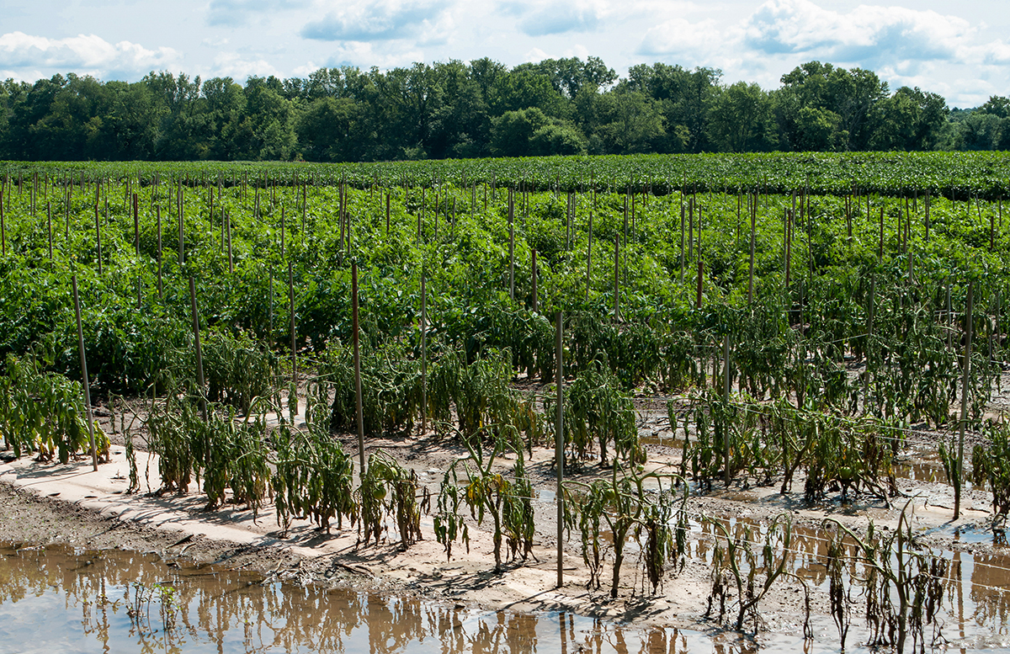
New York State Climate Assessment: Update
Farmworker health impacts from heat stress.
Crop and livestock impacts, including heat stresses to the growth and reproduction of plants and animals resulting in reduced crop yields and milk production.
Pest impacts, including increases in weeds that spread and infest fields, insects that feed on crops, and diseases that infect plants and reduce crop yields.
Impacts to the seasonal cycles of plant and animal life. For example, unseasonably warm temperatures in early spring can cause fruit trees to bloom early. When cold temperatures return, the buds can freeze and the fruit crop can be destroyed.
Financial impacts: Climate change can affect farm operating costs, food storage and transportation, and food prices.
BIGGEST IMPACTS FROM:
Heavy Precipitation; Extreme Drought
Heat Stress; Increased Pests & Diseases
https://nysclimateimpacts.org/
Notes:
The inner ring of the circular graph indicates the relative proportions represented by our major emissions sectors and the outer ring, the contribution of sources within each of those sectors. One of the key issues in our CLCPA framework is that we sort of exempted livestock contributions to emissions from regulation; but by the same token – we recognized in the Ag and Forestry chapter and in the science based integration analysis that the only way we reach our aggressive GHG emissions reductions goals is to find ways to incent steep decreases in methane emissions from our state – including from our livestock sector. So while not mandated – we have a sort of voluntary framework that prioritizes methane reductions.
Although many people tend to think of power plants (13%) as the major cause of climate change, here in NYS, the transportation (28%) and buildings (32%) sectors represent larger sources of emissions, and waste management (12%) is responsible for almost as much as power generation in NYS. Agriculture is an important but relatively small portion of NYS emissions (6%).

Slide 4
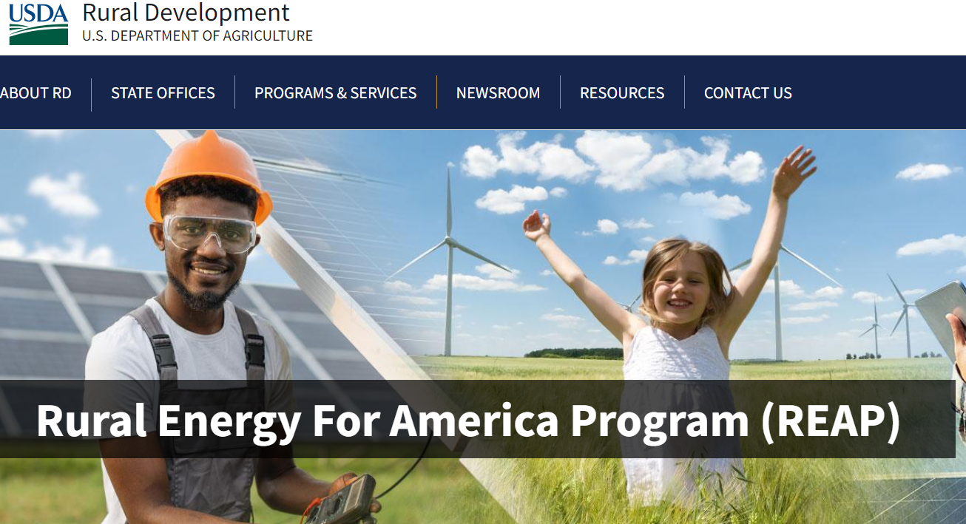
Resources to Use Rural Energy for America Program
https://www.rd.usda.gov/inflation-reduction-act/rural-energy-america-program-reap
https://www.rd.usda.gov/ny
Applications submitted on or after April 1, 2023 with projects that meet one of the following are eligible for a Federal grant share of up to 50 percent:
Renewable energy systems or retrofits that produce zero greenhouse gas emissions at the project level;
Projects located in an Energy Community defined in 26 U.S.C. 45 (b)(11)(B);
Energy efficiency improvement projects;
Projects proposed by eligible Tribal entities.
All other projects are limited to a Federal grant share of up to 25 percent.

Slide 5
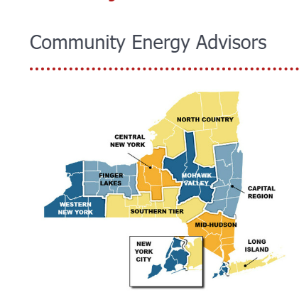
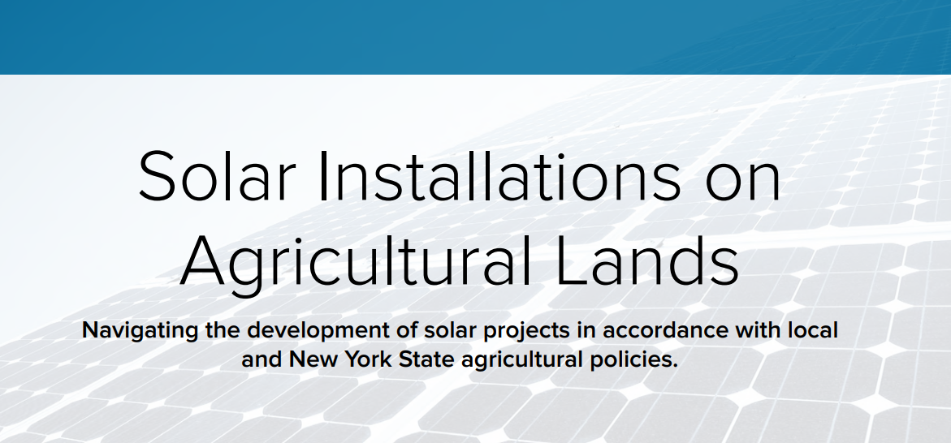
Resources to Use
For Residents: Clean Energy Hubs run by NYSERDA!
For Farmers:
https://blogs.cornell.edu/cceherkimer/2023/09/08/perspectives-on-the-opportunities-and-impacts-of-solar-installation-in-agricultural-areas/
https://www.agrisolarclearinghouse.org/
https://agenergyny.org/
https://agriculture.ny.gov/system/files/documents/2019/10/solar_energy_guidelines.pdf
https://www.nyserda.ny.gov/-/media/Project/Nyserda/Files/Programs/NY-Sun/2023-Solar-Installations-in-Agricultural-Lands.pdf
Notes:
NYS climate act provides a statutory goal setting in law. Our statutory responsibility now is to become a carbon neutral economy by 2050 – but what makes NY unique is the specific targets set forth to get there along the way and our re-framing of how we’re calculating our GHG emissions. 6 committees: Ag and Forestry; Just Transition; Power Generation, Transportation, Land Use and Local Governments, Energy Intensive and Trade Exposed Industries, Energy Efficiency & Housing – about 5 Cornellians appointed on different committees, one academic member on the overarching Climate Advisory Council. These Committees fed into a Climate Advisory Council debate, development of a draft scoping plan and we had extensive public comment and outreach throughout the state. Scoping plan adopted in December of 2022 – so now we are in the implementation phase which is honestly the hardest phase of all.

