Slide 1
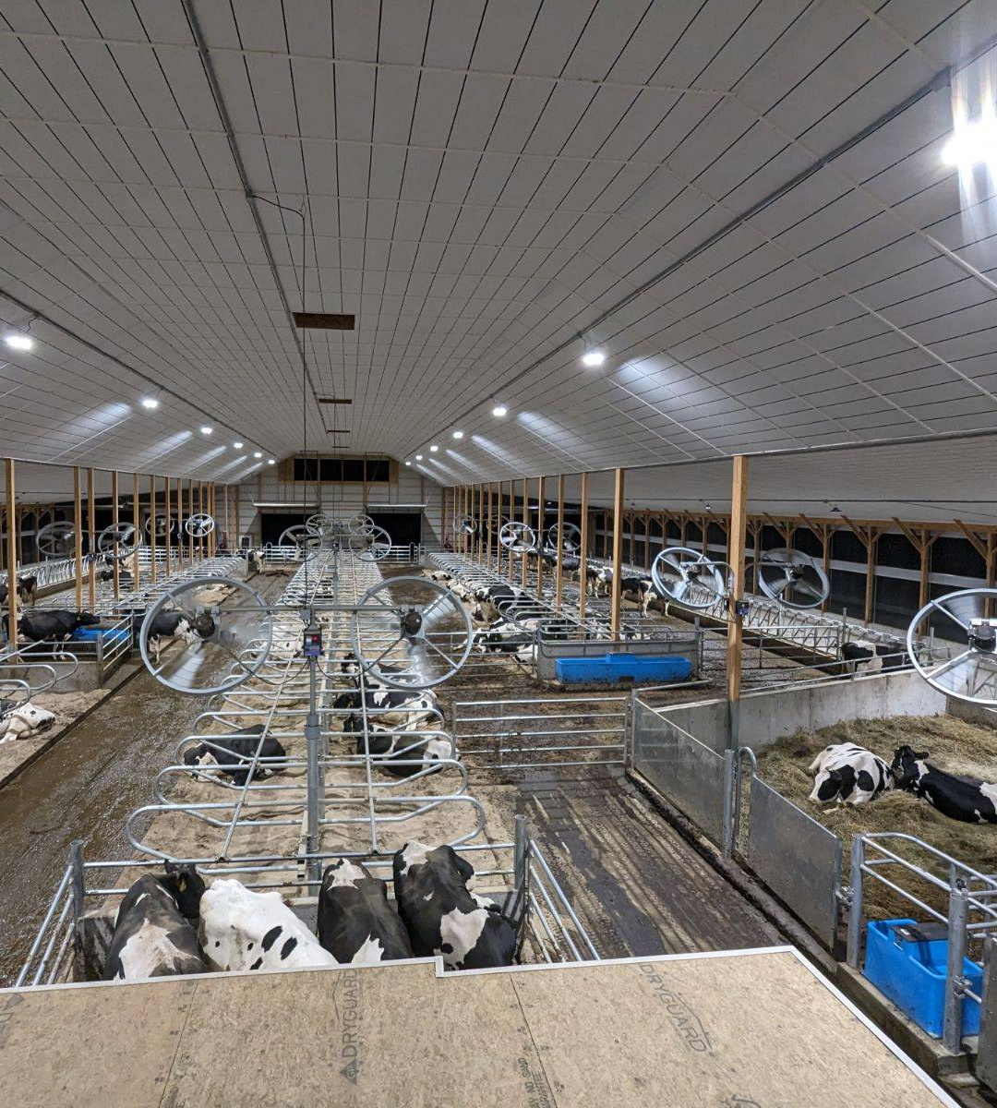
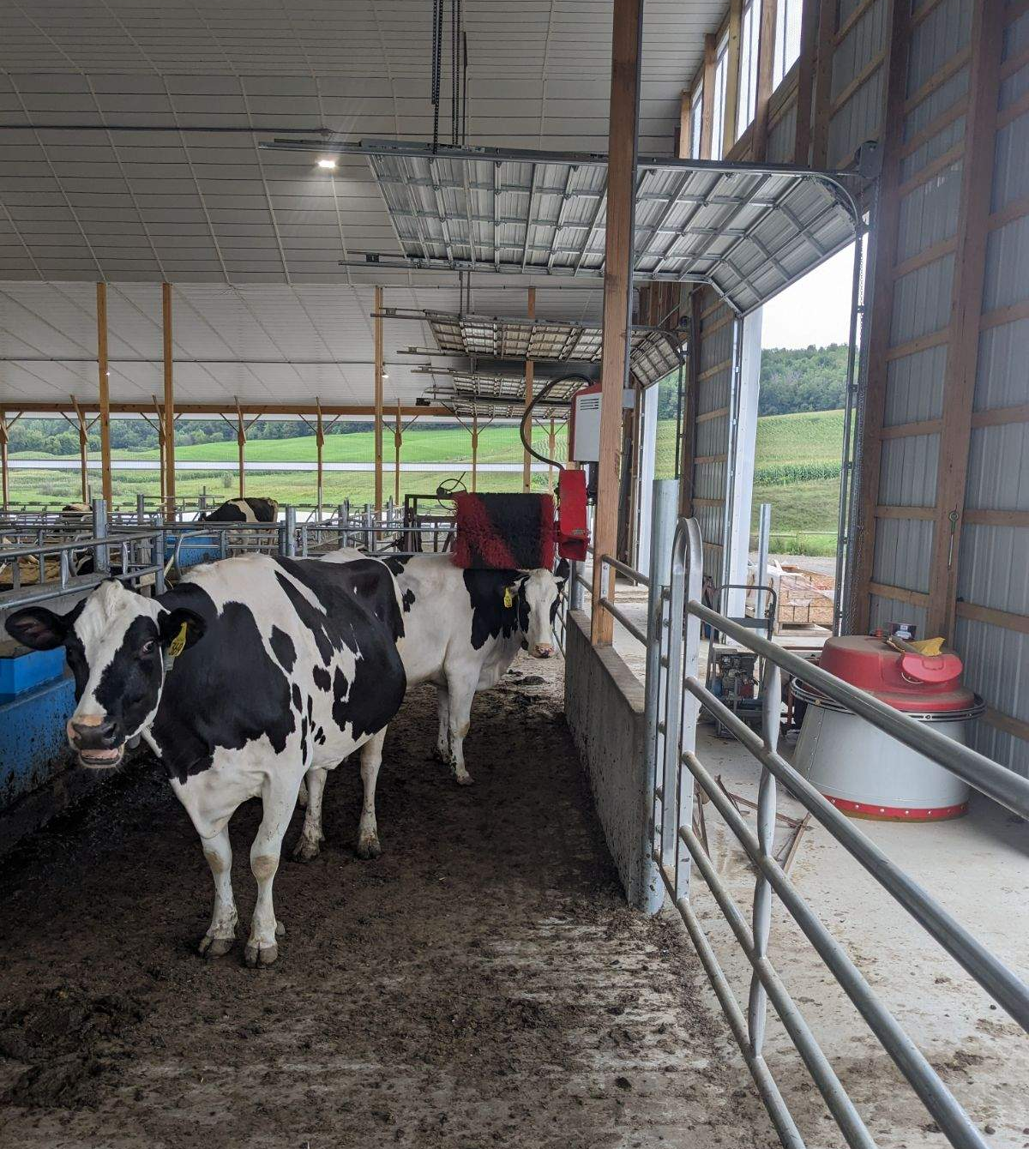
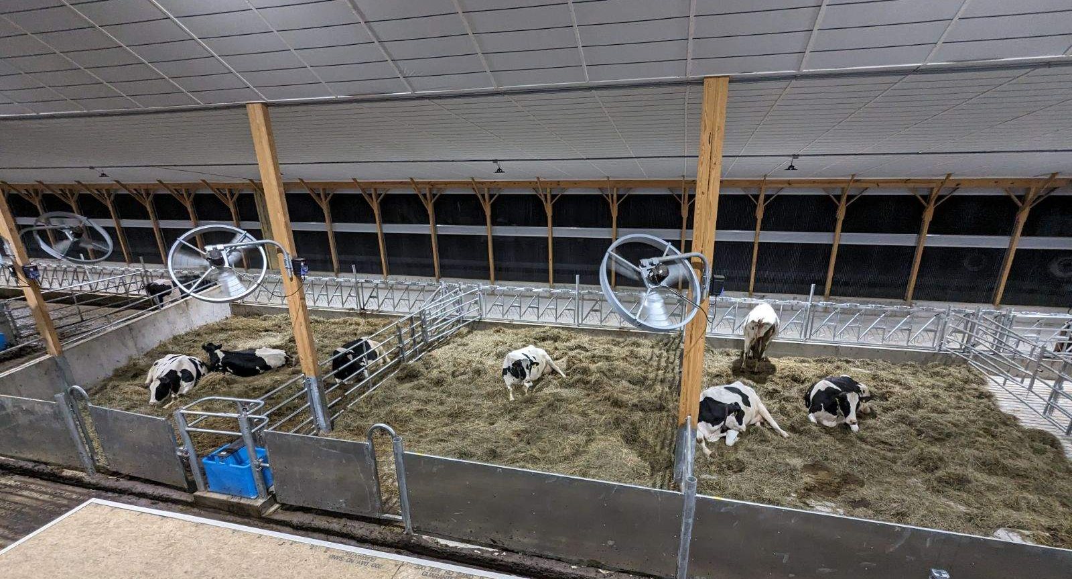
Brink Family Farm, Madison County National Grid and NYSERDA AEAP Program Participant
“In 2017 we built a 3 row free stall barn and installed two Lely Robotic Milkers. During this time we worked with National Grids Agribusiness Productivity Program [Economic Development] and also their Energy Efficiency Department.
“During this [farm expansion] project the Agribusiness Productivity Program helped pay, through a reimbursement, for the construction of a new barn and purchase of the robotic milkers. I also worked the energy efficiency program to purchase and install LED lighting, plate cooler, and variable speed fans.”
“… I just want to say thank you to all the guys from National Grid for all their help and for their financial support on all the projects they have worked with us on over the years.”

Slide 2
Brink Family Farm, Madison County
“Good morning, my name is Dylan Brink. I own and operate a dairy farm in Madison county with my parents (Gary and Carolyn) and my brother (Justin), We currently milk 180 cows on four Lely Robotic Milkers. Over the past 10 years we have had the privilege of working with National Grid and NYSERDA on a variety of projects to improving our energy efficiency and productivity.
When Seth asked me if I would be willing to talk at an event, I was quite hesitant and still am. The more I thought about it the more I hoped that I could be a blessing to someone by sharing my experience with working with National Grid Energy Efficiency and also the Agribusiness Productivity Programs [National Grid Economic Development].
In 2012 my mom and dad branched off of a dairy farm located in Tioga County where they were milking 250 cows through parallel parlor. In the spring of 2012 my parents purchased a 68 cow tie stall barn in Madison County to provide an opportunity for myself and two brothers to come back to the farm if we wanted to. We learned a lot about cows going from a free stall back to a tie stall. When we moved to New Woodstock we moved from NYSEG territory to National Grid territory. From 2012-2016 we focused on growing cow numbers. In 2017 we built a three row free stall barn and installed two Lely Robotic Milkers. During this time we worked with National Grids Agribusiness Productivity Program and also their Energy Efficiency Program.
What is the ag-business productivity grant? This grant program is a reimbursement to help incentive projects that increase energy efficiency, renewable energy and/or productivity improvements. So what does that look like? National grid will consider incentivizing projects that purchase new equipment that uses electricity such as, robotic feed pushers, robotic milkers, electric manure pumps and/or agitators. This program can also help incentives renewable energy such as solar. In Madison county we have worked with Brian Anderson and he has been great to work with and helped clarify questions as I had them. During this project the agri-business program helped pay, through a reimbursement, for the construction of a new barn and purchase of the robotic milkers. I also worked with Bob Mueller in the energy efficiency department to purchase and install LED lighting, plate cooler, and variable speed fans.
We continued milking cows in both the tie stall and robot barn from 2017-2023. On August 8th 2023 we completed construction on a six row free stall barn and two more Lely Robotic Milkers. On this project we worked with Brian Anderson with the
Agri-business productivity grant and also with Seth Browe in the energy efficiency department. I can't stress enough how great these guys are to work with. They understand we as farmers might not understand all the terms they use in their grants but are super helpful to answer questions as they come up. For this project we again used the agri-business productivity grant to help offset the cost of the free stall and robotic milkers. I also worked with Seth Browe from the energy efficiency department to purchase new bulk tank compressors, variable speed fans, automated curtains, high speed load out pump and LED lighting.
If you haven't worked with National Grid before, their on the spot lighting incentive program is super easy and would be a great place start making upgrades on your farm. This program has pre-approved incentive for certain light fixtures. For example we were able to purchased 150 watt high bay lights for $1.00 each.
Again I just want to say thank you to all the guys from national grid for all their help and for their financial support on all the projects I they have worked with us on over the years.”

